Slide 1
Python Microservices and its Frameworks
(SANIC)
Nikhil Kumar

Slide 2
AGENDA
1
Python
4
Sanic And Async
Why Python?
Sanic and Async working and benefits
2
Microservices
5
Demo
Monolith vs Microservices
Project on Conference Management System
3
Popular Frameworks
6
Contact Us
Django, Flask & Sanic
Keep in touch

Slide 3
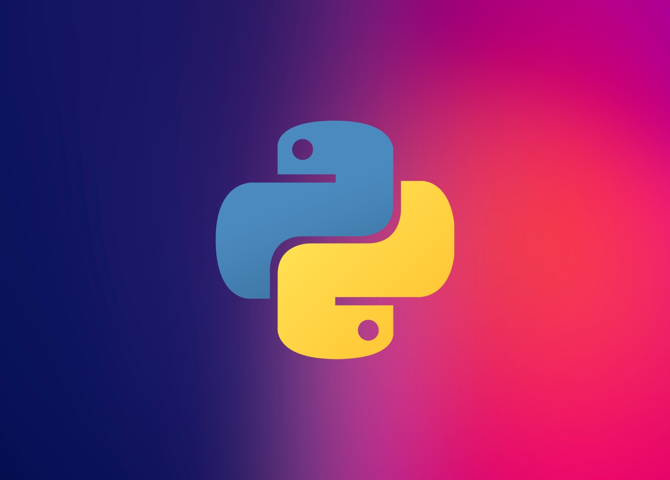
01
PYTHON

Slide 4
01
Easy to Read, Learn & Write
Why Python?
02
Free and Open-Source
03
Vast Libraries Support
04
Dynamically Typed
05
ML/AI extensions
06
Scripting Language

Slide 5

02
Microservices

Slide 6
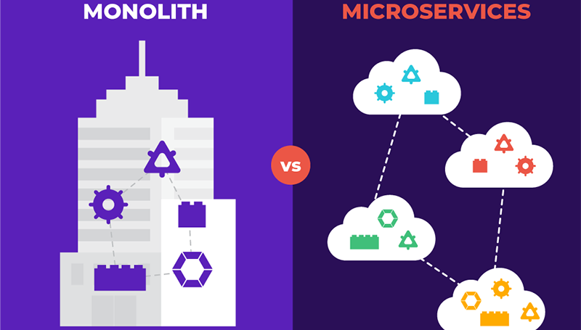
Monolith vs Microservices
MONOLITH - If all the functionalities of a project exists in a single codebase, then that application is known as monolithic application.
MICROSERVICES - It is an architectural development style in which the application is made up of smaller services communicating with each other directly using lightweight protocols like HTTP

Slide 7
01
Improved productivity
Breaking app into autonomous services makes it easier to maintain
Benefits of Microservice Architecture
02
Better resiliency
Easy to identify root cause of performance issues
03
Increased scalability
Individual services can also be scaled independently
04
CI/CD
Leads to faster deployment and troubleshooting turnaround times
05
Optimize business functionality
Existing services can then be adapted for use in different contexts
06
Tech Stack Freedom
Can choose most suitable tech stack for each microservice

Slide 8
03
Python Popular Frameworks

Slide 9

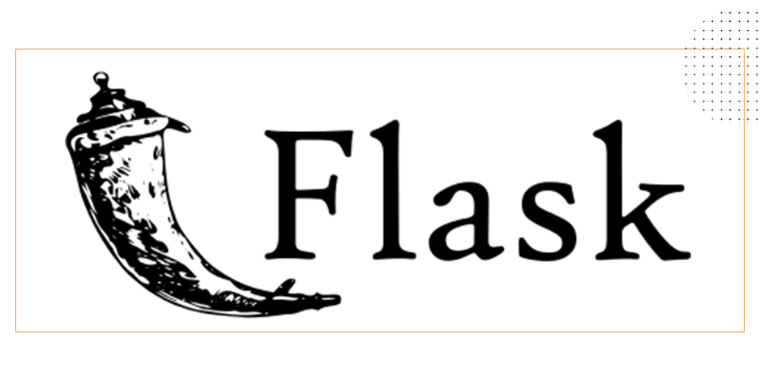
Django vs Flask
Django
Flask
Full Stack Framework
Doesn’t offer multiple types of databases
Offers a Monolithic working style
Web Server Gateway Interface Framework
Allows you to use multiple types of databases
Offers Microservice working style

Slide 10
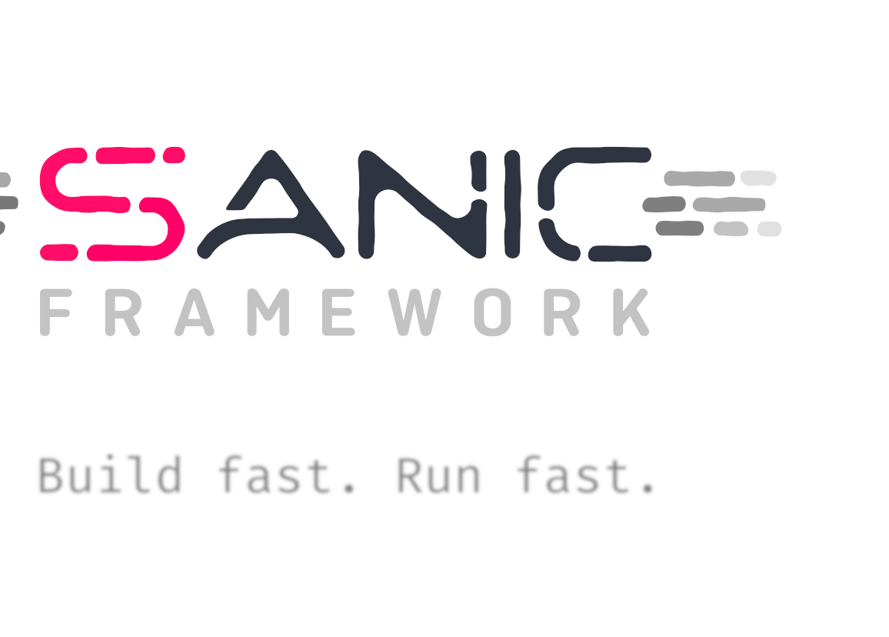
04
SANIC & Async

Slide 11




FAST
ASGI COMPLAINT
ASYNC / AWAIT
Written to go fast
&
Similar to Flask
ASGI (Asynchronous Server Gateway Interface) is a spiritual successor to WSGI, intended to provide a standard interface between async-capable Python web servers, frameworks, and applications.
Allows the usage of the async/await syntax added in Python 3.5, which makes your code non-blocking and speedy

Slide 12
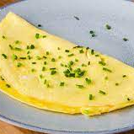

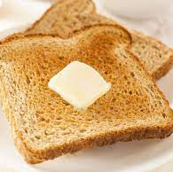
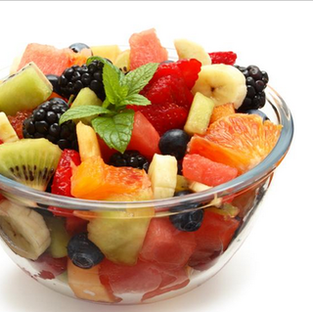
ASYNC
Breakfast Example
Omelet
Coffee
Toast
Fruits (chopped)
Beat the eggs with a fork..
Melt the butter
Add Eggs and heat on low flame
Heat Milk
Beat the Coffee with sugar and water
Mix it with Milk
Switch On Toaster
Put Bread in Toaster
Wait till the ring sound
Take all the fruits
Wash them
Peel and Chop

Slide 13

05
Demo
Conference Management

Slide 14
Conference Management
Conference – Title, Description, Start Date, End Date
Talk – Title, Description, Duration, Date & Time, Speakers & Participants (A conference can have multiple talks under it)
Speaker/Participant - Username, Email (Each talk will have a list of speakers and participants)
Create APIs :-
To create/edit a conference
To add/edit a talk
To list talks in a conference
To list conferences

Slide 15
DEMO
CMS
Nikhil Kumar
https://github.com/nikhilkumar96/conference

Slide 16
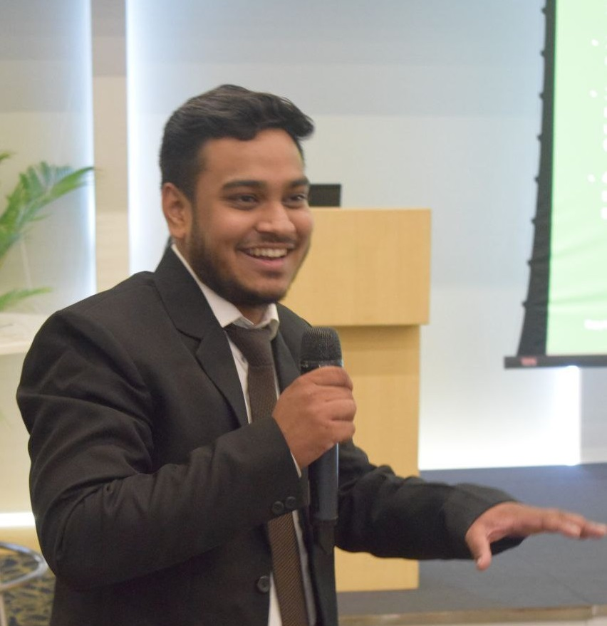
KEEP IN TOUCH!
https://www.linkedin.com/in/nikhil-kumar-aa200a99/
https://github.com/nikhilkumar96/conference

Slide 17
THANK YOU FOR ATTENDING!
ANY QUESTIONS?

